Slide 1
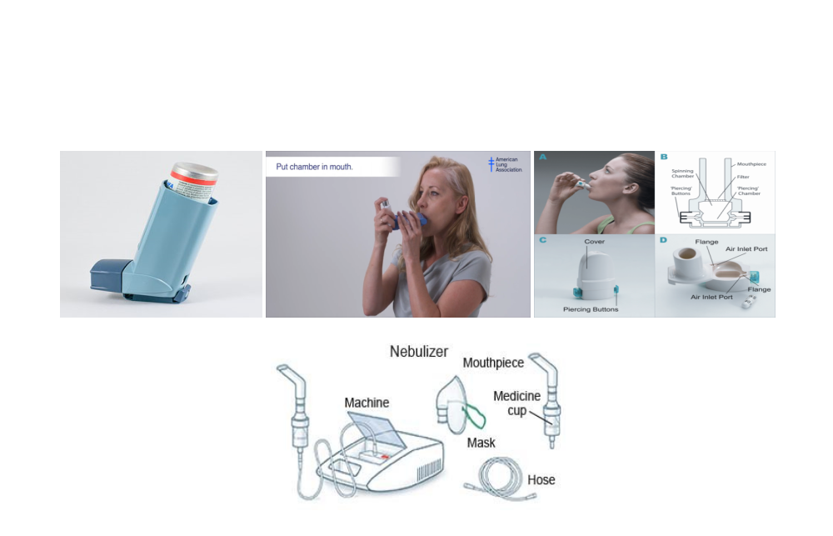
TECHNIQUES OF
INHALATIONAL DEVICES
By Sr. Subhra Mondal,
NS

Slide 2
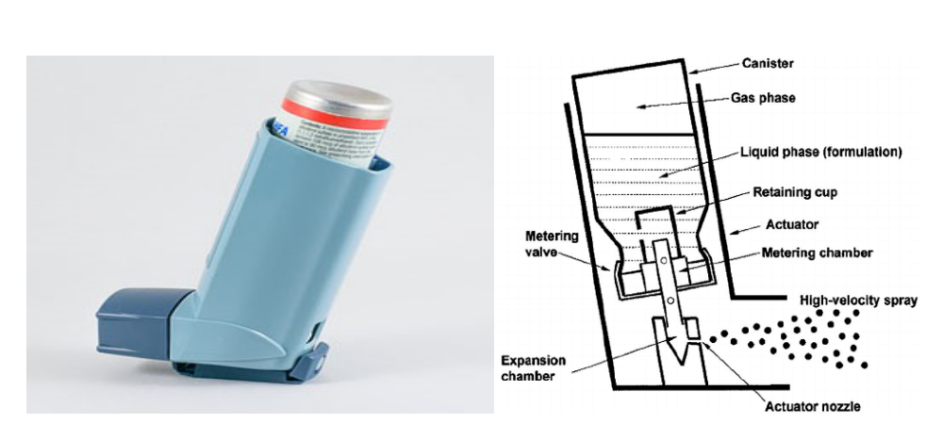
Q. How many types of inhalational devices are used for treatment of respiratory disorders?
Metered dose inhalers (MDIs), Dry powder inhalers (DPIs), and Nebulisers are the most commonly used modes of aerosol drug delivery that are used to treat respiratory disorders.
Metered-dose inhaler (MDI): It uses a chemical propellant to push the medication out of the inhaler into the lungs.

Slide 3
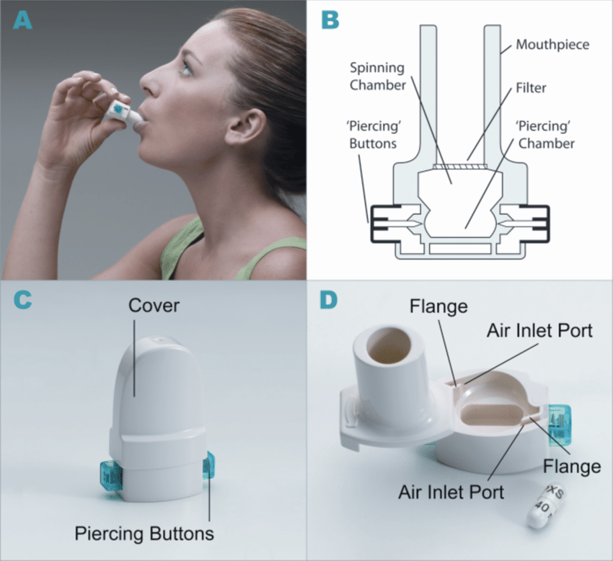
Dry powder inhaler (DPI): It delivers medication without using chemical propellants, but it requires strong and fast inhalation.

Slide 4
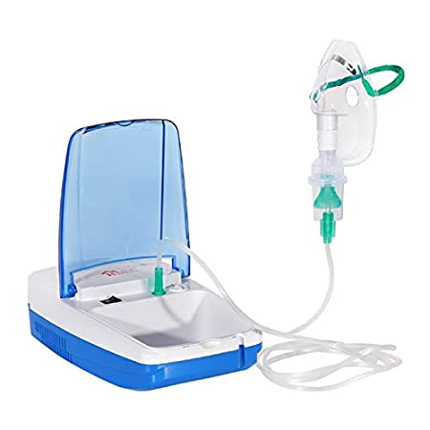
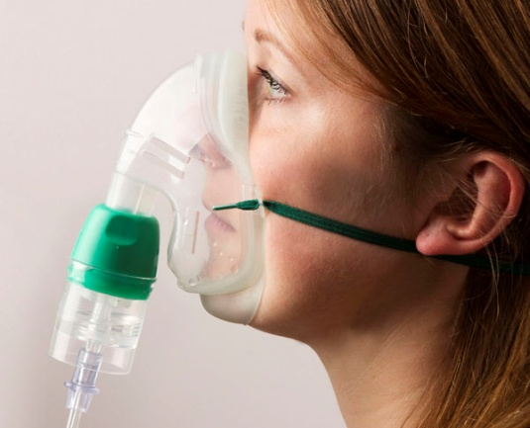
Nebuliser: It delivers fine liquid mists of medication through a tube or a mask that fits over the nose and mouth, using air or oxygen under pressure.

Slide 5
Q. Name some commonly used drugs given through inhalational devices
BRONCHODIALATORS-
Salbutamol
Levosalbutamol
Formoterol
Salmeterol
Ipratropium
Tiotropium
Glycopyrronium
CORTICOSTEROIDS-
Budesonide
Beclomethasone
Fluticasone
Mometasone

Slide 6
Q. When and how many times the inhalers/nebulisations should be taken?
Inhalers and nebulisations should be taken as per doctor’s prescription. Maintenance/fixed dose inhalers/nebulisers should be taken at fixed times of the day. Inhalers/nebulisers prescribed by the doctor for relieving acute symptoms should be taken according to doctor’s instructions.
Q. How to take the correct amount of medicines?
Doctor prescribes necessary doses in form of number of puffs (for metered dose inhalers), capsules (for dry powder inhalers) or respules (for nebulisers). Patient has to take the medicines according to the dose prescribed.

Slide 7
Q. what can be the possible side effects of the inhalational drugs?
Some possible side effects of drugs are as follows-
Palpitations
Tachycardia
Restlessness, nervousness, tremors
Headache and dizziness
Hyperglycemia
Mouth dryness and throat irritation
Oral thrush
Hoarseness of voice
Weight gain, oedema
Despite the possibility of these adverse effects, drugs used through inhalers/nebulisers are very safe to use.

Slide 8
Q. Are inhalers and nebulisers addictive?
Drugs used through inhalers and nebulisers are absolutely not addictive. We can easily discontinue the medications if needed without any complications.
Q. Should you take less drug dose when you feel better?
No. Patient should not change the prescribed dose of inhalers/nebulisers without consulting the doctor.

Slide 9
Q. How to clean and maintain the inhalational devices?
Cleaning of MDI -
Metered dose inhalers should be cleaned at least once each week. Never wash the metal canister or put it in water (only wash the plastic parts).
Remove the metal canister from the plastic casing from the inhaler and remove the mouth piece cap.
Rinse the plastic casing thoroughly under running water.
Let the plastic casing air dry over night.
Put the metal canister into the plastic casing, test by releasing a single puff into the air and replace the mouth piece cap.
If spacer is used along with MDI, the parts of the spacer are to be dismantled, rinsed thoroughly under running water and let it air dry.

Slide 10
Cleaning of DPI -
The Dry powder inhaler device should also be cleaned at least once a week.
Wipe the mouth piece of DPI device with a clean, dry cloth.
Never use water to wipe the DPI because the powder is sensitive to moisture.
Cleaning of Nebulisers –
Nebuliser mask/mouthpiece needs regular cleaning daily and deep cleaning once a week.
Dismantle the nebuliser cup, mask and mouthpiece into parts.
Soak the components in soapy water using mild detergents.
After 30 minutes, rinse thoroughly.
Air dry in a cool, dry place.
For deep cleaning, after washing, soak the components into one part white vinegar to three part water solution for 30 minutes, then rinse well and let air dry.
Clean the surface of nebuliser compressor and nebuliser tubing with damp washcloth or disinfectant wipes.
Don’t submerge the compressor and tubing in the water.

Slide 11
Storing of Inhalers –
Keep the cap on the inhalers.
Keep the inhaler at dry cool place.
Store all medicine safely out of reach of children and pets
Q. What to do if you miss a regular dose of medicines?
If a drug dose is missed or forgot to take a dose, it should be taken as soon as remembered. If it is nearly time to next dose, skip the missed dose and take next scheduled dose.
Q. What to do if you run out your medicines?
Always check the dose counters if available in case of using MDI. The number of doses available in an MDI is clearly written on the package. Patient should always have stock of inhaler medicines well in advance before it gets depleted.

Slide 12
Techniques of using Metered Dose Inhalers (MDI) with and without spacer
Remove the cap.
Shake the inhaler.
Hold inhaler in a horizontal position.
Keep head upright.
Breathe out to the end of normal breath slowly.
Place the mouthpiece between teeth and lips and close lips around mouthpiece properly.
While breathing in slowly and deeply through your mouth, fully press down once on the top of the metal canister of your inhaler.
Remove inhaler from mouth and hold breath for about 10 seconds.
After 10 seconds breathe out slowly.
If more than one spray is required, wait 15 to 30 seconds before taking the next puff. Then repeat steps 3-9.
Replace the cover.
Wash the mouth and throat after use.

Slide 13
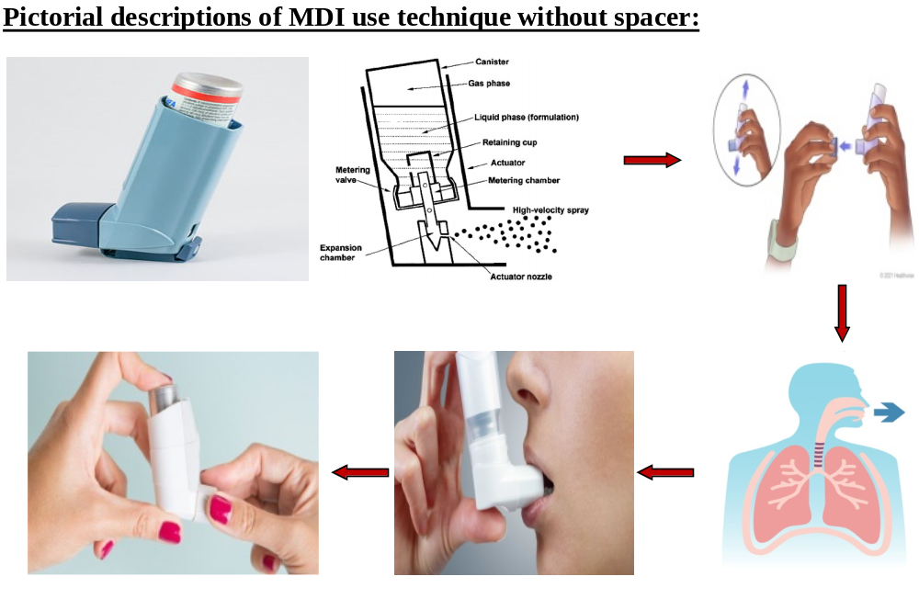

Slide 14
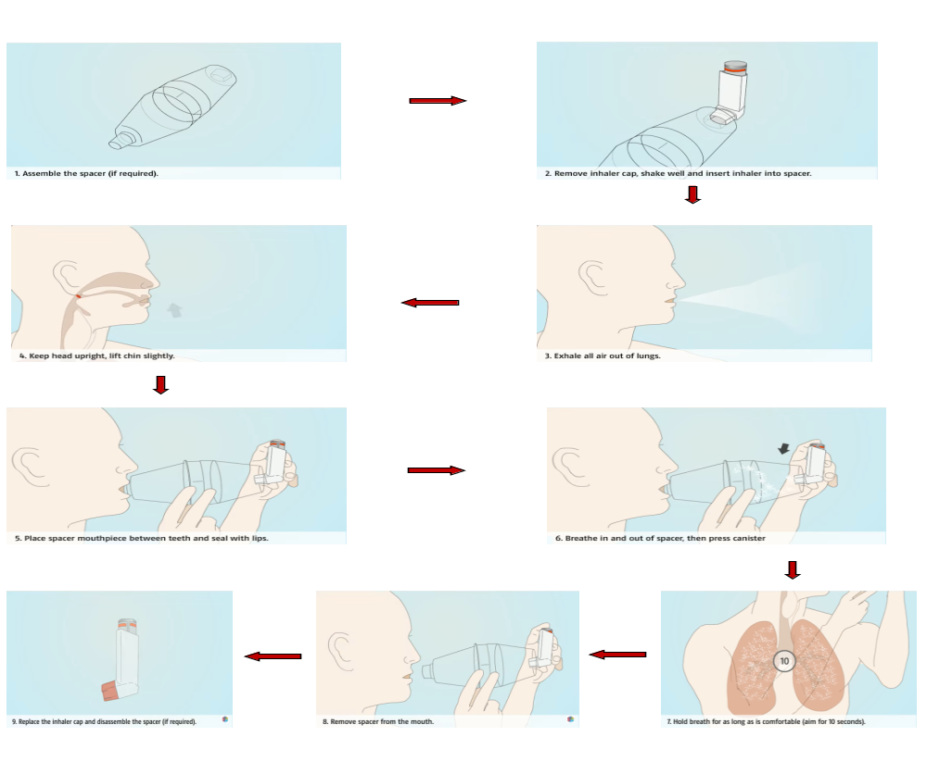
Pictorial descriptions of MDI use technique with spacer:

Slide 15
Techniques of using Dry Powder Inhaler (DPI):
Remove the cap, if there is one.
Add or load a medicine according to the device instructions.
Hold inhaler in a horizontal position.
Keep head upright.
Breathe out to the end of normal breath slowly.
Place the mouthpiece between teeth and lips and close lips around mouthpiece properly.
Breathe in strongly and deeply.
Remove inhaler from mouth and hold breath for about 10 seconds.
After 10 seconds breathe out slowly.
If another dose is to be taken, reload the medication and repeat steps 3-9.
Replace the cover, if present.
Wash the mouth and throat after use

Slide 16
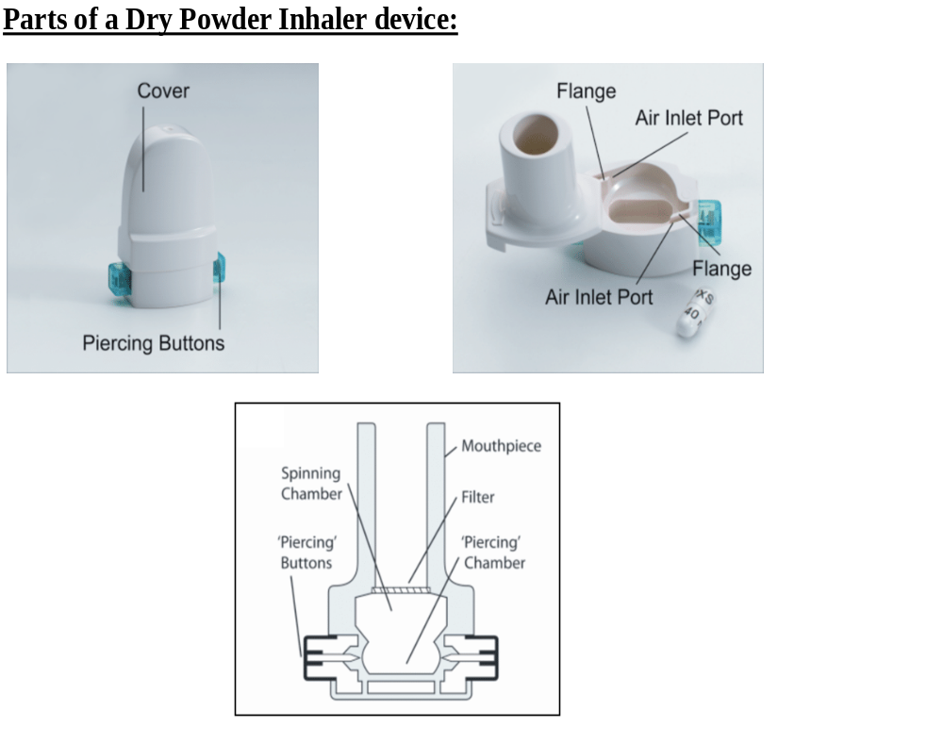

Slide 17
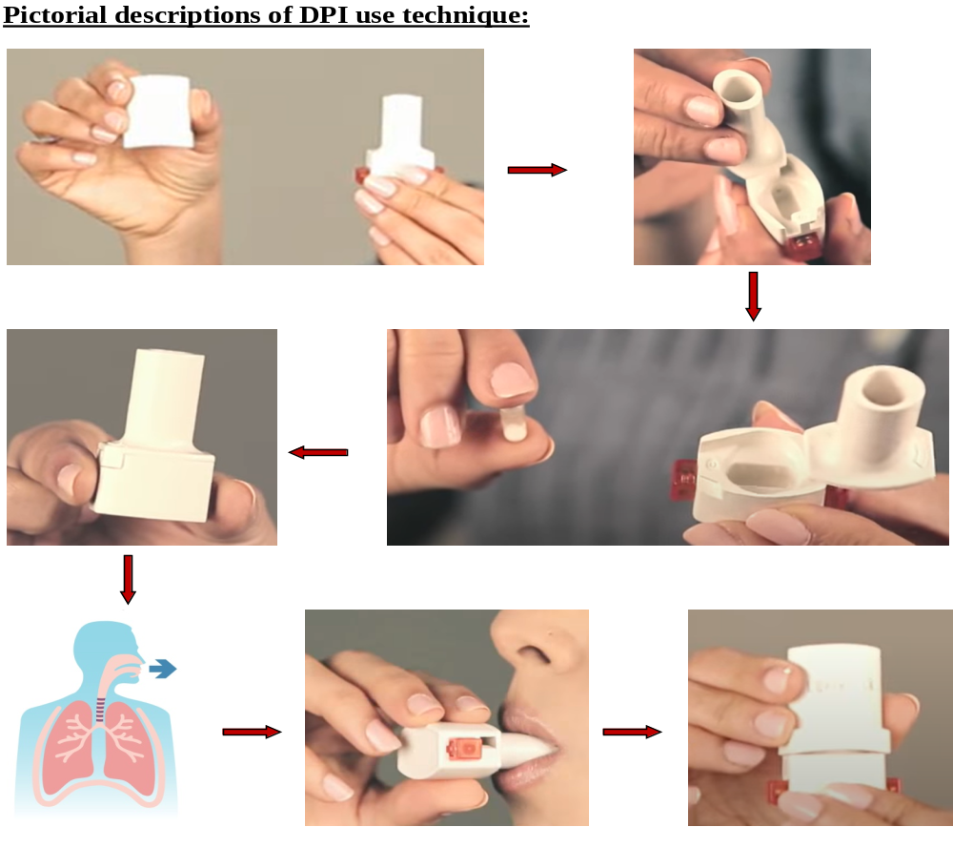

Slide 18
Techniques of using Nebulisers:
Assemble the different components of the nebuliser.
Fill the medicine into the nebuliser reservoir.
Turn on the compressor.
Fit the facemask on the face properly.
Seat straight and keep head upright.
Inhale the drugs forcefully and deeply.
Breathe out completely in between.
Remove the mask after completion of drugs.
Dismantle and clean nebuliser parts after nebulization.
Wash the mouth and throat after nebulization.

Slide 19
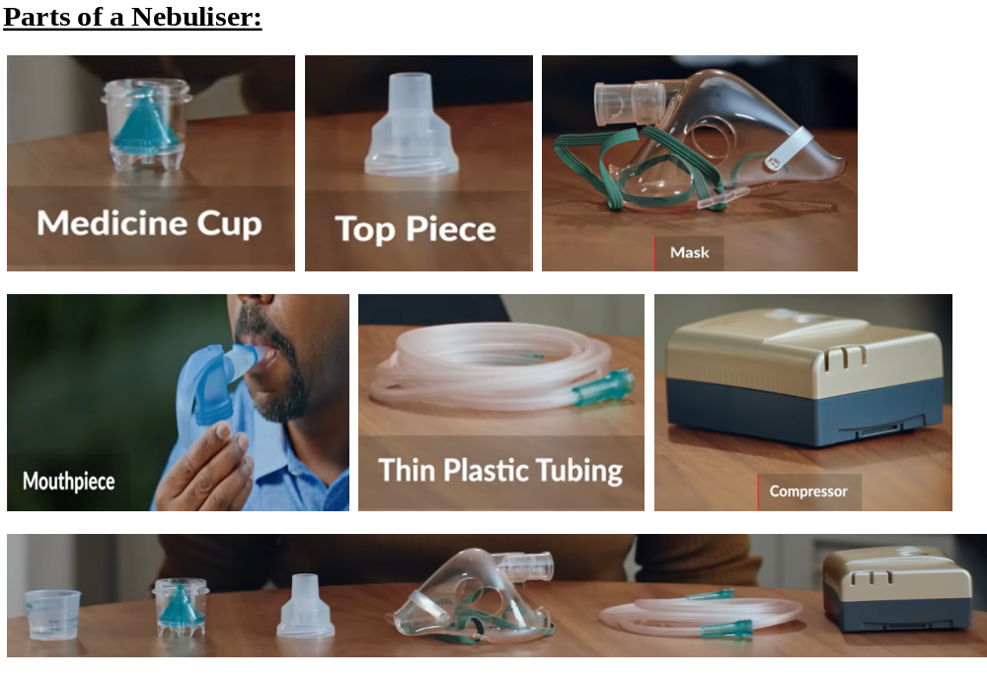

Slide 20
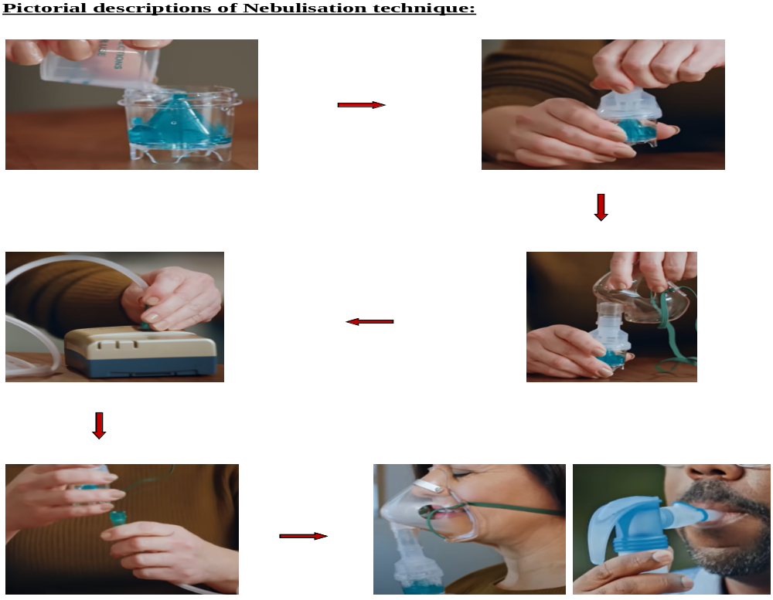

Slide 21
Tool validation certificates

Slide 22
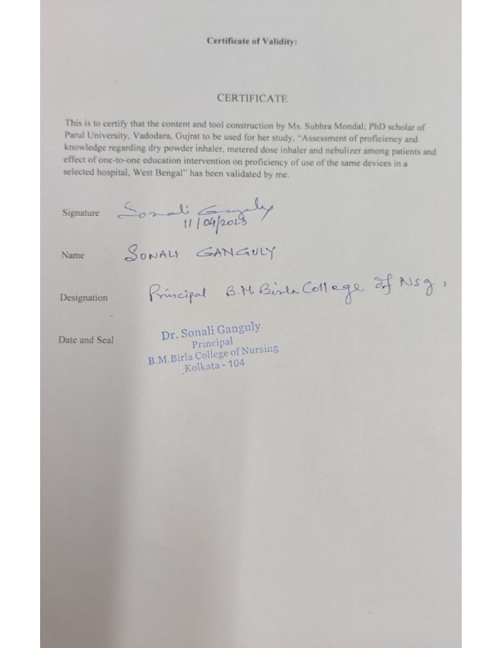

Slide 23
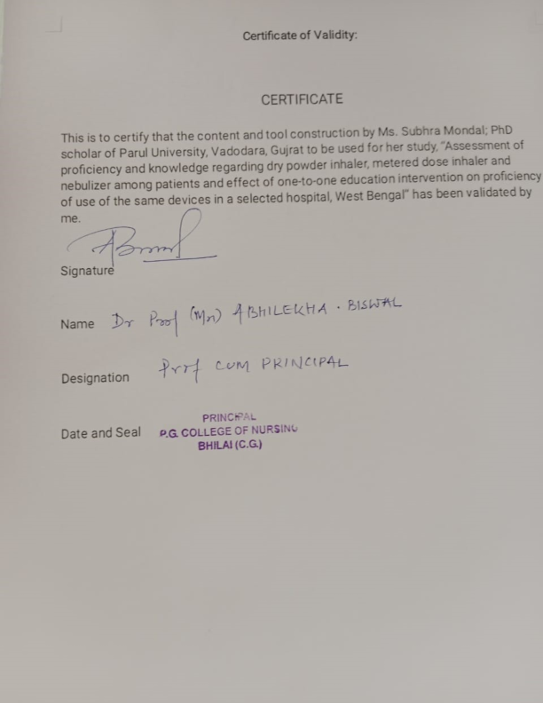

Slide 24
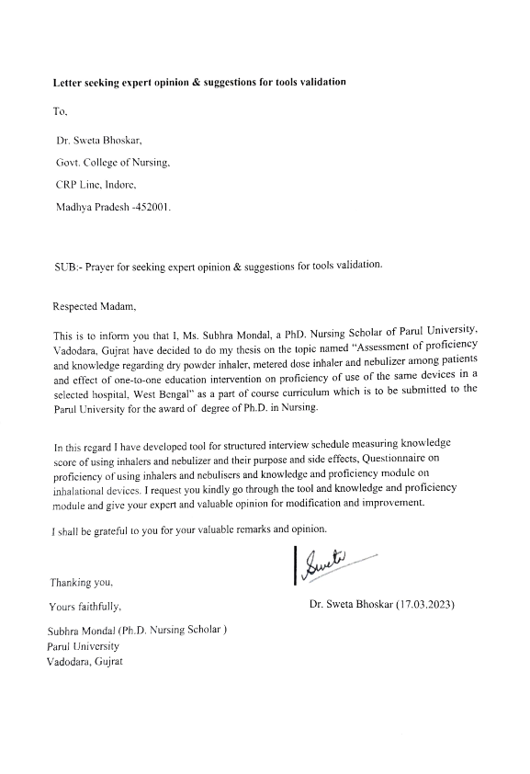

Slide 25
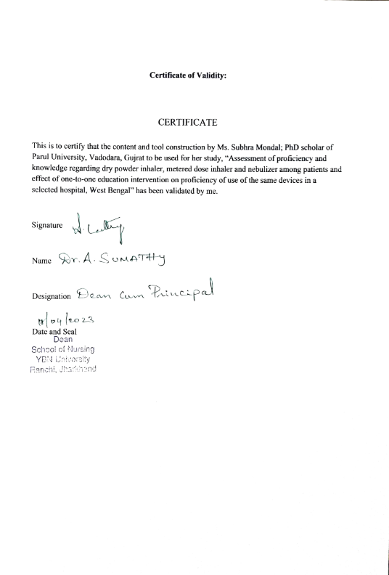

Slide 26
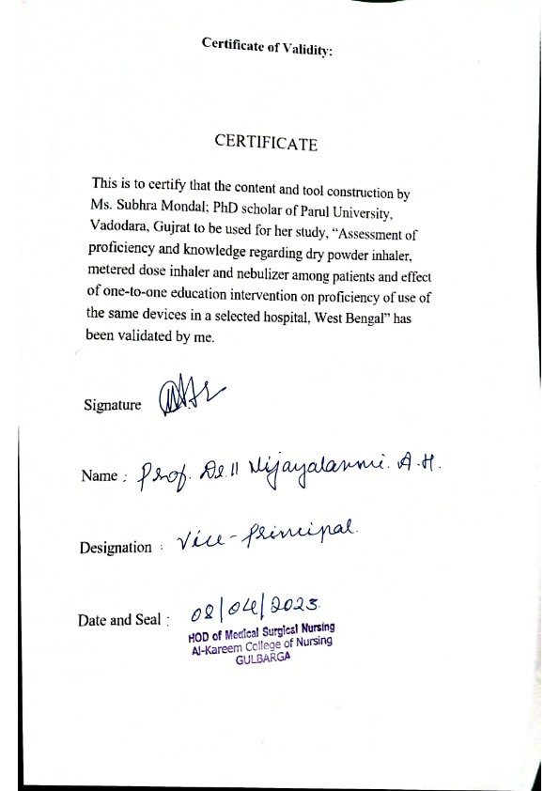

Slide 27
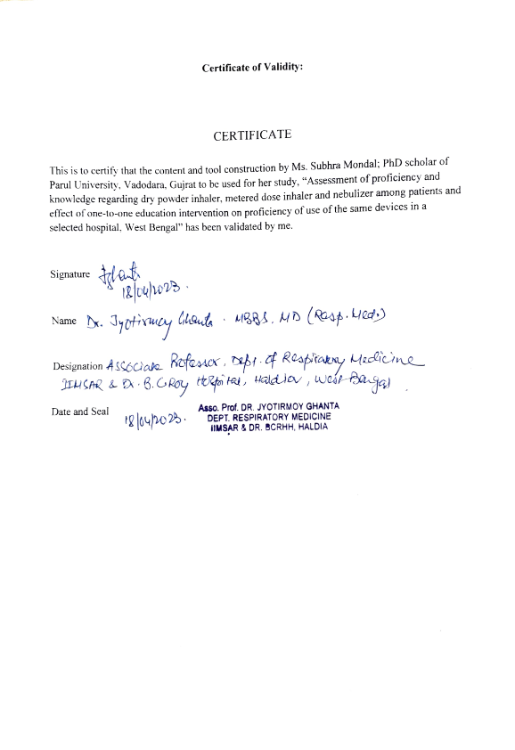

Slide 28
REFERENCE:
World Health Organization Chronic obstructive pulmonary disease (COPD); Fact sheet. 16th Mar, 2023. [Accessed April 18, 2023]. Available from: https://www.who.int/news-room/fact-sheets/detail/chronic-obstructive-pulmonary-disease-(copd)
Lavorini F. The challenge of delivering therapeutic aerosols to asthma patients. ISRN Allergy. 2013 Aug 5;2013:102418. doi: 10.1155/2013/102418.
Lakshmi Prassana MN, Ramanath, Sreedharan Nair, Girish Tunga, Aziz Unnisa. Assessment of the knowledge of usage of inhalers among health-care professional student community. Asian Journal of Pharmaceutical and Clinical Research, vol. 12, no. 6, June 2019, pp. 107-9, doi:10.22159/ajpcr.2019.v12i6.9237.
Global Initiative for Asthma. Global Strategy for Asthma Management and Prevention, 2022. [Internet] [Updated July 01, 2022, cited April 04, 2023]. Available at: https://ginasthma.org/wp-content/uploads/2022/07/GINA-Main-Report-2022-FINAL-22-07-01-WMS.pdf
Global Initiative for Chronic Obstructive Lung Disease. Global Strategy for the Diagnosis, Management and Prevention of Chronic Obstructive Pulmonary Disease, 2023 report. [Internet] [Updated Feb 17, 2023, cited April 04, 2023]. Available at: https://goldcopd.org/wp-content/uploads/2023/03/GOLD-2023-ver-1.3-17Feb2023_WMV.pdf
Lizano-Barrantes C, Garin O, Dima AL, Van Ganse E, De Bruin M, Belhassen M, Mayoral K, Pont À, Ferrer M. The Inhaler Technique Questionnaire (InTeQ): development and validation of a brief patient-reported measure. International journal of environmental research and public health. 2022 Feb 23;19(5):2591.
Sawant SS, Ghanekar J, Dasila PK. To Assess Effectiveness of Planned Teaching Program on Knowledge and Skills of Staff Nurses Regarding Use of Selected Devices in the Management of Respiratory Disorders in Selected Hospital of Urban Area. Research Journal of Pharmacy and Medical Sciences (IRJPMS). 2022;5(6):76-9.
Press VG, Arora VM, Kelly CA, Carey KA, White SR, Wan W. Effectiveness of virtual vs in-person inhaler education for hospitalized patients with obstructive lung disease: a randomized clinical trial. JAMA network open. 2020 Jan 3;3(1):e1918205.

Slide 29
REFERENCE:
Kshatriya RM, Khara NV, Paliwal RP, Patel SN. Evaluation of proficiency in using different inhaler devices among intern doctors. Journal of Family Medicine and Primary Care. 2016 Apr 1;5(2):362-6.
Al-Kalaldeh M, El-Rahman MA, El-Ata A. Effectiveness of nurse-driven inhaler education on inhaler proficiency and compliance among obstructive lung disease patients: a quasi-experimental study. Canadian Journal of Nursing Research. 2016 Jun;48(2):48-55.
Daniel RA, Aggarwal P, Kalaivani M, Gupta SK. Prevalence of chronic obstructive pulmonary disease in India: A systematic review and meta-analysis. Lung India. 2021 Nov-Dec;38(6):506-513. doi: 10.4103/lungindia.lungindia_159_21.

